Slide 1
REPLICATION

Slide 2



Slide 3
Replication
Replication is the process in which DNA is unzipped and each side is used as a template (pattern) onto which new nucleotides bond.
This produces two new copies of the original molecule
They are exactly the same as the original and joined at the ‘centromere’

Slide 4
Replication
Enzymes are used in replication to
Unwind and unzip the DNA
Join on new nucleotides
“Proofread” and join gaps in new strands

Slide 5
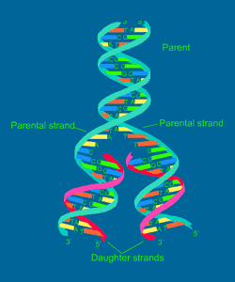
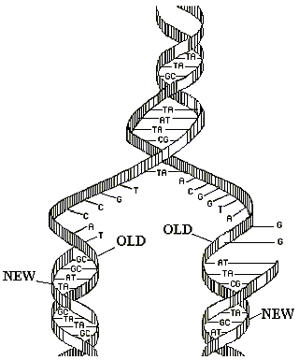

Slide 6
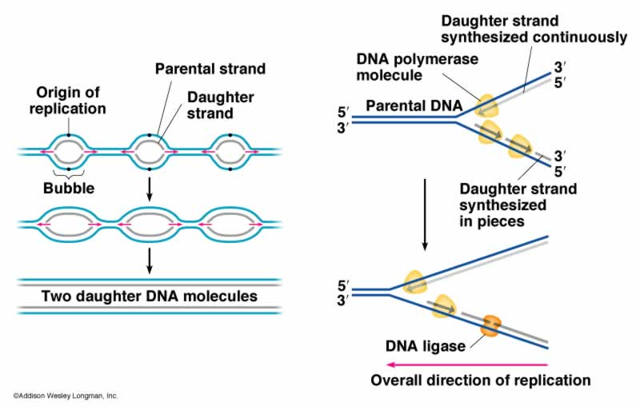

Slide 7
